Slide 1
The Srub Lords.
Done by: G8T4

Slide 2
Today’s Agenda
Functionalities
Schedule
Evaluation Metrics
Roles & Responsibilities
Programming Pairs

Slide 3
Functionalities
1
DO YOU PLAN TO DROP/ADD ANY FUNCTIONALITIES?
No. We do not plan to drop/add any functionalities.

Slide 4
Functionalities
1
DO YOU PLAN TO USE ANY PHP FRAMEWORKS?
No. We did not use any PHP Frameworks.

Slide 5
Functionalities
1
DID YOU MANAGE TO FINISH LOGIN + 1 FUNCTIONALITY?
Yes. We finished both Login & Bootstrap Functionality.

Slide 6
Functionalities
1
WHAT IS THE IP ADDRESS AND ADMIN PASSWORD FOR YOUR CLOUD DEPLOYMENT?
IP Address: 18.219.90.60
Password: XmP1z!MPr[

Slide 7
Schedule
2
OVERVIEW SCHEDULE SUMMARY
Iteration 1 (Week 5 to 6): 17 Sept — 30 Oct
Iteration 2 (Week 7 to 8): 1 Oct — 14 Oct
Iteration 3 (Week 9 to 10): 15 Oct — 28 Oct
Iteration 4 (Week 11 to 12): 29 Oct to 11 Nov
Iteration 5 (Week 13 ): 12 Nov — 19 Nov
Front-End development for login and ( Pair 2) homepage
Implement Bootstrap feature (Pair 1)
Create test cases and test login page
Update bug metrics
Creation of JSON, JSON Checker (Pair 1)
Implement JSON Functionalities and validations (Pair 1)
Implement of bidding features (Pair 2)
Implement admin functionality (Pair 1)
Run test cases and update bug metrics
Preparation for application demo and progress update
Implement clearing logic (Round 2) feature (Pair 1)
Implement live bidding (Round 2) feature (Pair 2)
Design Front-End for admin page
Create test cases for clearing logic & live bidding
Preparation for UAT
Refining existing website after UAT’s feedback (Pair 1)
Implementation of additional requirements (Pair 2)
Prepare for final presentation
Prepare for final presentation
Runthrough final presentation
Present on Final Presentation

Slide 8
Milestones
2
OUR MILESTONES SUMMARY
Milestone description | Dates | Venue
Project Management Review | Week 7 | in-Class
Application Demo and Progress Update | Week 9 | Online
User Acceptance Test (UAT) | Week 11 | in-Class
Post Review on UAT | Week 12 | in-Class
Final Presentation | Week 13 | in-Class

Slide 9
Buffer Time
2
BUFFER TIME FOR EACH ITERATION
No buffer time.

Slide 10
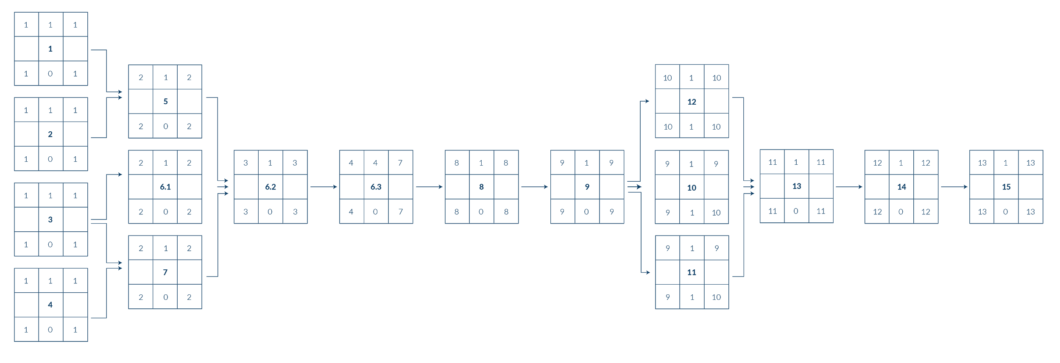
Critical Path: Iteration 1
2
SCHEDULE SUMMARY

Slide 11
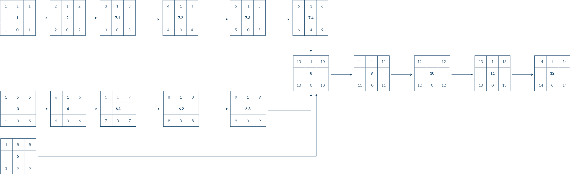
Critical Path: Iteration 2
2
SCHEDULE SUMMARY

Slide 12
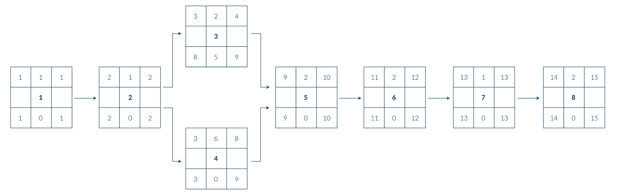
Critical Path: Iteration 3
2
SCHEDULE SUMMARY

Slide 13
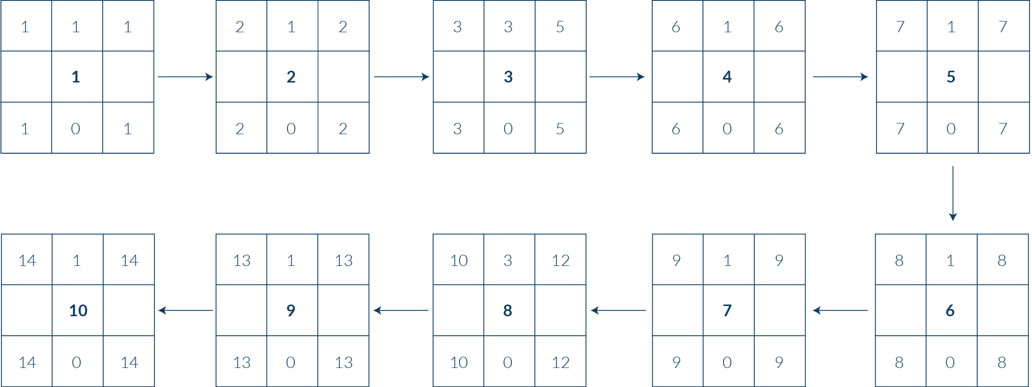
Critical Path: Iteration 4
2
SCHEDULE SUMMARY

Slide 14
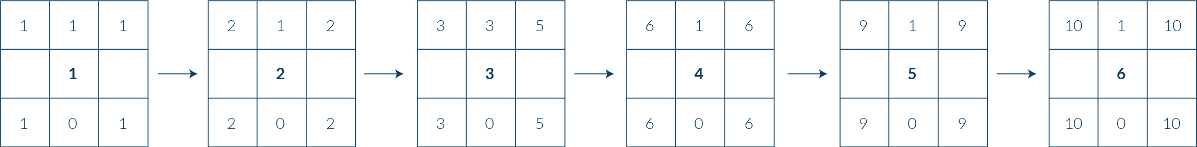
Critical Path: Iteration 5
2
SCHEDULE SUMMARY

Slide 15
Bug Metrics
3
CALCULATION OF IMPACT SCORE & MITIGATION PLAN
Calculation of Impact Score
Severity |  |  | Description
Low Impact (Score = 1) |  |  | Inconsequential. Simple typo error or minor user interface misalignment
High Impact (Score = 5) |  |  | Non-critical functionalities are not working, but the system still runs
Critical Impact (Score = 10) |  |  | The system or core functionality is down. Immediate attention is required
Mitigation Plan
Points in Iteration |  |  | Action
Points < 10 |  |  | Use the planned debugging time in the iteration.
Points ≥ 10 |  |  | Stop current development and resolve the bug immediately. Project Manager reschedules the project.

Slide 16
Bug Metrics
3
WHAT IS THE CURRENT VALUE OF METRICS & ANY MITIGATION PLAN?
Iteration 1
S/N | Function | Description | Severity | Points | Final Bug Metric | Mitigation
1 | Bootstrap | Crashes on upload with an "undefined variable" | High | 5 | 66 | Stop current development and resolve the bug immediately. Project Manager reschedules the project.
2 |  | Crashes on upload with $header returning a BOOLEAN instead of an array | High | 5
3 |  | Does not return $results sorted alphabetically | Low | 1
4 | Login | Front-end Development (All in HTML) does not match with Back-end (PHP, JSON) | High | 5

Slide 17
Bug Metrics
3
WHAT IS THE CURRENT VALUE OF METRICS & ANY MITIGATION PLAN?
Iteration 1
S/N | Function | Description | Severity | Points | Final Bug Metric | Mitigation
5 | Login | Only allows login with ‘@’ included due to input type = email | High | 5 | 66 | Stop current development and resolve the bug immediately. Project Manager reschedules the project.
6 |  | Able to access admin page through student user authentication and vice versa | High | 5
7 |  | Does not return expected test case for JSON authentication | High | 5
8 |  | Upon entering a successful/unsuccessful name/password in the website leads to a blank page | Critical | 10

Slide 18
Bug Metrics
3
WHAT IS THE CURRENT VALUE OF METRICS & ANY MITIGATION PLAN?
Iteration 1
S/N | Function | Description | Severity | Points | Final Bug Metric | Mitigation
9 | Login | Entering the website for the first time shows ‘Invalid Token’ | Low | 1 | 66 | Stop current development and resolve the bug immediately. Project Manager reschedules the project.
10 | Bootstrap | Uploading the file on bootstrap.php shows a blank page | Critical | 10
11 |  | When access to ‘bootstrap-process.php’ directly, it shows undefined index | High | 5
12 | Login | When access to ‘login.php’ for the first time, it shows error messages of ‘Username should not be empty’ and ‘Password should not be empty’ | High | 5

Slide 19
Bug Metrics
3
WHAT IS THE CURRENT VALUE OF METRICS & ANY MITIGATION PLAN?
Iteration 1
S/N | Function | Description | Severity | Points | Final Bug Metric | Mitigation
13 | Login | Able to access student timetable planner page without logging in/admin authentication | Low | 1 | 66 | Stop current development and resolve the bug immediately. Project Manager reschedules the project.
14 |  | Able to access student check out bid page without logging in/admin authentication | Low | 1
15 |  | Unable to logout from student timetable planner and checkout bid page | Low | 1
16 |  | Unable to access student homepage from student time planner and check out bid page | Low | 1

Slide 20
Roles & Responsibilities
4
ROLES FOR EACH MEMBER PER ITERATION
Iteration 1 (Project Management Review)
Roles | Member
Project Manager | Glen
Pair 1 | Glen & Mary
Pair 2 | Agnes & Kwan Yang
Iteration 2 (Application Demo and Progress Update)
Roles | Member
Project Manager | Mary
Pair 1 | Glen & Agnes
Pair 2 | Kwan Yang & Shourya

Slide 21
Roles & Responsibilities
4
ROLES FOR EACH MEMBER PER ITERATION
Iteration 3 (User Acceptance Test (UAT))
Roles | Member
Project Manager | Agnes
Pair 1 | Glen & Shourya
Pair 2 | Mary & Kwan Yang
Iteration 4 (Post Review on UAT)
Roles | Member
Project Manager | Shourya
Pair 1 | Glen & Kwan Yang
Pair 2 | Agnes & Mary

Slide 22
Roles & Responsibilities
4
ROLES FOR EACH MEMBER PER ITERATION
Iteration 5 (Final Presentation)
Roles | Member
Project Manager | Kwan Yang
Pair 1 | Glen & Mary
Pair 2 | Agnes & Shourya

Slide 23
Thank you.
Done by: G8T4

